Slide 1
An Orientation to Market Structure

Slide 2
MARKETS AND ITS FORMS
Economists have classified industries into four distinct market structures on the basis of following aspects;
The number of Firms in the Industry
Produce Standardized products or Differentiate their products
Control over Price
The Entry of firms into Industry (as well as exit from the industry)

Slide 3
Market Structure
Perfect
Competition
Pure Monopoly
More competitive (fewer imperfections)

Slide 4
Market Structure
Perfect
Competition
Pure Monopoly
Less competitive (greater degree of imperfection)

Slide 5
Market Structure
Perfect
Competition
Pure Monopoly
Monopolistic Competition
Oligopoly
Duopoly
Monopoly
The further right on the scale, the greater the degree of monopoly power exercised by the firm.

Slide 6
Market Structure
Models – a word of warning!
  Market structure deals with a number of economic ‘models’
  These models are a representation of reality to help us to understand what may be happening in real life
  There are extremes to the model that are unlikely to occur in reality(perfect competition & pure monopoly)
  They still have value as they enable us to draw comparisons and contrasts with what is observed in reality
  Models help therefore in analysing and evaluating – they offer a benchmark

Slide 7
Market Structure
Characteristics of each model:
  Number and size of firms that make up the industry
  Control over price or output
  Freedom of entry and exit from the industry
  Nature of the product – degree of homogeneity (similarity) of the products in the industry (extent to which products can be regarded as substitutes for each other)
  Diagrammatic representation – the shape of the demand curve, revenue curve etc.

Slide 8
MARKETS AND ITS FORMS
The four distinct market models are;
Perfect Competition
Monopolistic Competition
Oligopoly
Monopoly

Slide 9
CHARACTERISTICS OF MARKET MODELS
Characteristics | Perfect Competition | Monopolistic Competition | Oligopoly | Monopoly
No. of Firms | A very large No. | Many | Few | One
Type of Product | Standardized / Homogeneous | Differentiated | Standardized or Differentiated | Unique, no close substitute
Control over Price | None (price taker) | Some, but within narrow limits | Limited by mutual interdependence | Considerable (Price maker)
Conditions of Entry | Very easy, no obstacles | Relative easy | Significant Obstacles | Blocked
Non-price competition | None | Emphasis on advertising, brand names, trademarks | Typically a great deal, particularly with product differentiation | Mostly public relations, Advertising

Slide 10
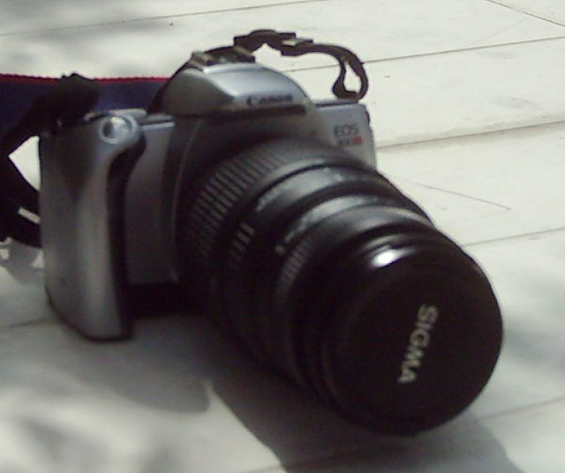
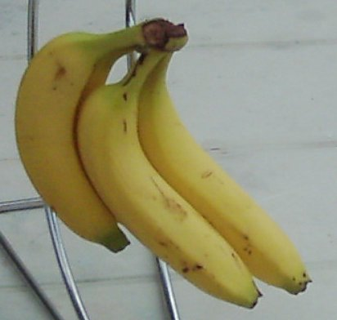
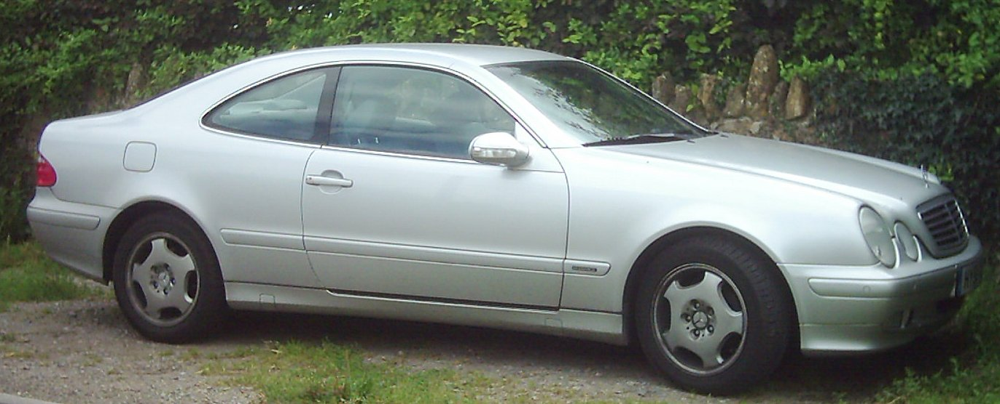
Market Structure
Characteristics: Look at these everyday products – what type of market structure are the producers of these products operating in?
Remember to think about the nature of the product, entry and exit, behaviour of the firms, number and size of the firms in the industry.
You might even have to ask what the industry is??
Mercedes CLK Coupe
Canon SLR Camera
Bananas

Slide 11

